Slide 1
Carbon, water and nitrogen cycles
These elements are vital for life as we know it and they CYCLE through our ecosystems.
This means that they are re-usable.
They enter our systems as one thing, are used and often leave our systems as another, only to reappear.
They sometimes ‘rest’ in a reservoir, or pool.

Slide 2
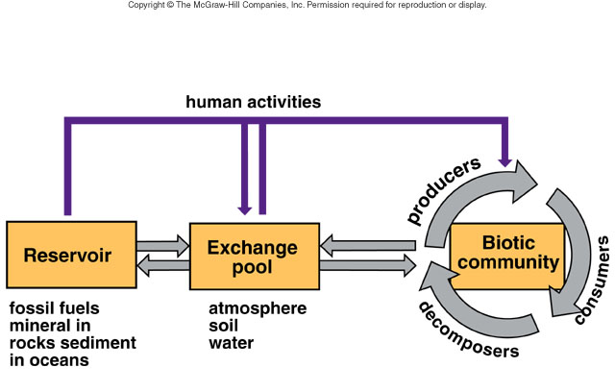
Model for chemical cycling
Notes:
Chemical nutrients cycle between these components of ecosystems. Reservoirs, such as fossil fuels, minerals in rocks, and sediments in oceans, are normally relatively unavailable sources, but exchange pools in the atmosphere, soil, and water are available sources of chemicals for the biotic community. While human activities remove chemicals from reservoirs and pools and make them available to the biotic community, pollution can result.

Slide 3
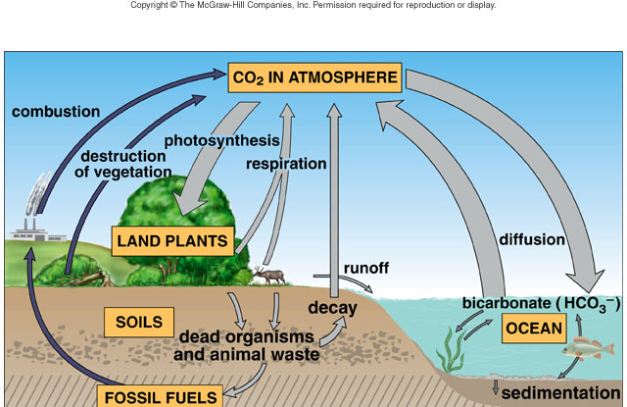
The carbon cycle
Notes:
Purple arrows show human activities; gray arrows represent natural events.

Slide 4
The Carbon Cycle
In the carbon cycle, a gaseous cycle, organisms exchange carbon dioxide with the atmosphere.
Shells in ocean sediments, organic compounds in living and dead organisms, and fossil fuels are all reservoirs for carbon.
Fossil fuels were formed during the Carboniferous period, 286 to 360 million years ago.

Slide 5
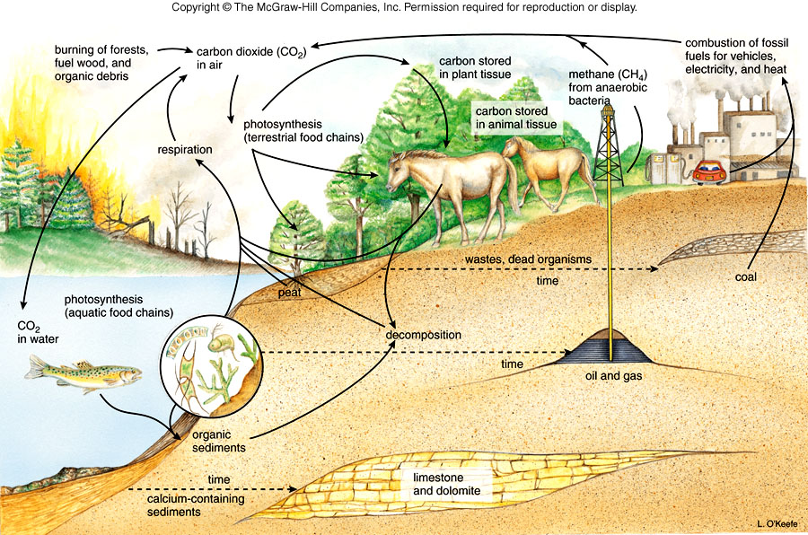
CARBON CYCLE

Slide 6
The Water Cycle
In the water, or hydrologic cycle, the sun’s rays cause fresh water to evaporate from the oceans, leaving the salts behind.
Vaporized fresh water rises into the atmosphere, cools, and falls as rain over oceans and land.
Precipitation, as rain and snow, over land results in bodies of fresh water plus groundwater, including aquifers.
Notes:
Water under the soil surface forms a water table and rock layers may hold water in aquifers.

Slide 7
Water is held in lakes, ponds, streams, and groundwater.
Evaporation from terrestrial ecosystems includes transpiration from plants.
Eventually all water returns to the oceans.
Groundwater “mining” in Gnangarra Aquifer is removing water faster than underground sources can be recharged.

Slide 8
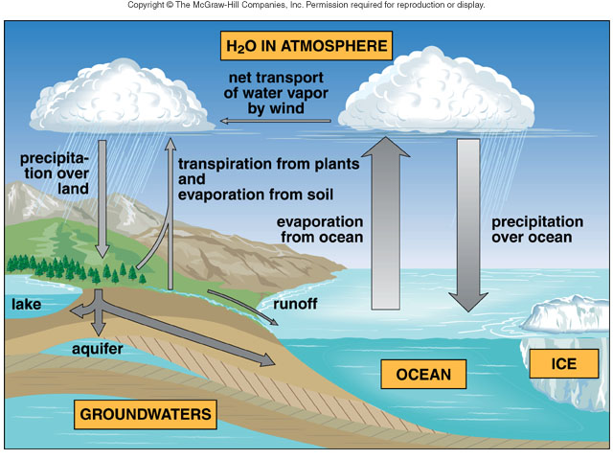
The water cycle

Slide 9
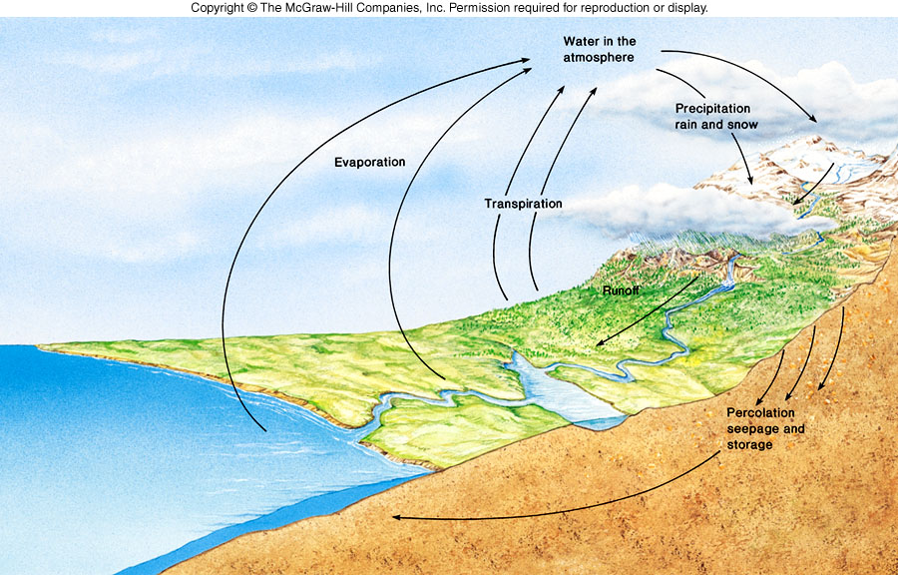
WATER CYCLE

Slide 10
The Nitrogen Cycle
Nitrogen makes up 78% of the atmosphere but plants are unable to make use of this nitrogen gas and need a supply of ammonium or nitrate.
The nitrogen cycle, a gaseous cycle, is dependent upon a number of bacteria.
During nitrogen fixation, nitrogen-fixing bacteria living in nodules on the roots of legumes convert atmospheric nitrogen to nitrogen-containing organic compounds available to a host plant.

Slide 11
Cyanobacteria in aquatic ecosystems and free-living bacteria in the soil also fix nitrogen gas.
Bacteria in soil carry out nitrification when they convert ammonium to nitrate in a two-step process: first, nitrite-producing bacteria convert ammonium to nitrite and then nitrate-producing bacteria convert nitrite to nitrate.
During denitrification, denitrifying bacteria in soil convert nitrate back to nitrogen gas but this does not quite balance nitrogen fixation.

Slide 12
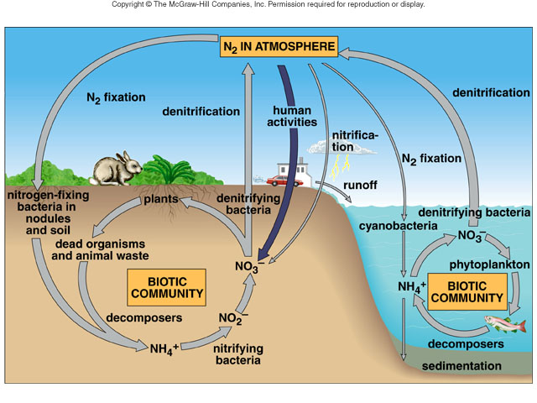
The nitrogen cycle

Slide 13
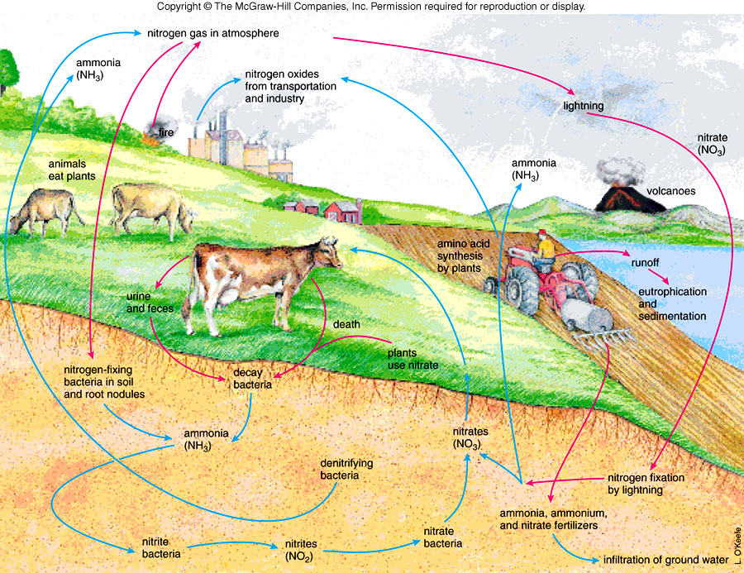
NITROGEN CYCLE

Slide 14
Nitrogen and Air Pollution
Human activities convert atmospheric nitrogen to fertilizer which when broken down by soil bacteria adds nitrogen oxides to the atmosphere at three times the normal rate.
Humans also burn fossil fuels which put nitrogen oxides (NOx) and sulfur dioxide (SO₂) in the atmosphere.

Slide 15
Nitrogen oxides and sulfur dioxide react with water vapor to form acids that contribute to acid deposition.
Acid deposition is killing lakes and forests and also corrodes marble, metal, and stonework.
Nitrogen oxides and hydrocarbons (HC) react to form photochemical smog, which contains ozone and PAN (peroxyacetylnitrate), oxidants harmful to animal and plant life.

Slide 16
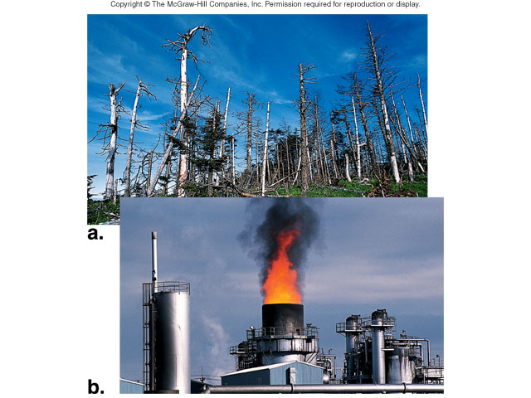
Acid deposition
Notes:
Many forests in higher elevations of northeastern North America and Europe are dying due to acid deposition. Air pollution due to emissions from factories and fossil fuel burning is the major cause of acid deposition, which contains nitric acid (H₂NO₃) and sulfuric acid (H₂SO₄).

Slide 17
A thermal inversion, where these pollutants are trapped under warm, stagnant air concentrates pollutants to dangerous levels.
Nitrous oxide is not only a greenhouse gas, but contributes to the breakdown of the ozone shield that protects surface life from harmful levels of solar radiation.
Notes:
The Health Focus for Chapter 34 (pages 710-711) is entitled Ozone Shield Depletion.

Slide 18
Thermal inversion
Notes:
(Top) Normally, pollutants escape into the atmosphere when warm air rises. (Middle) During a thermal inversion, a layer of warm air (warm inversion layer) overlies and traps pollutants in cool air below. (Bottom) Los Angeles is particularly susceptible to thermal inversions, and this accounts for why this city is the “air pollution capital” of the United States.

Slide 19
The Phosphorus Cycle
The phosphorus cycle is a sedimentary cycle.
Only limited quantities are made available to plants by the weathering of sedimentary rocks; phosphorus is a limiting inorganic nutrient.
The biotic community recycles phosphorus back to the producers, temporarily incorporating it into ATP, nucleotides, teeth, bone and shells, and then returning it to the ecosystem via decomposition.
Notes:
phosphorus does not enter the atmosphere.

Slide 20
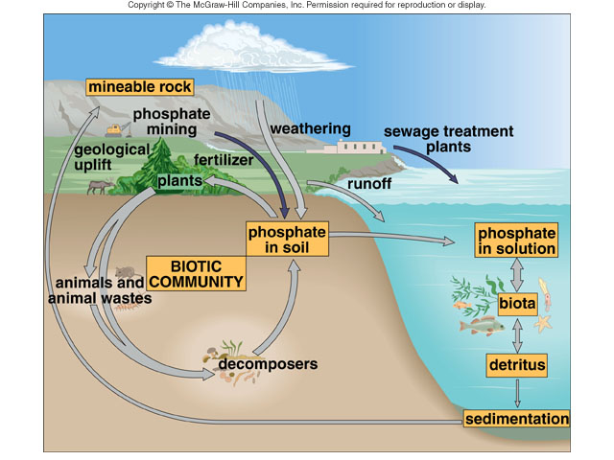
The phosphorus cycle

Slide 21
Phosphorus and Water Pollution
Phosphates are mined for fertilizer production; when phosphates and nitrates enter lakes and ponds, eutrophication occurs.
Many kinds of wastes enter rivers which flow to the oceans; oceans are now degraded from added pollutants.
If pollutants are not decomposed, they may increase in concentration as they pass up the food chain, a process called biological magnification.
Notes:
Eutrophication is over-enrichment of an aquatic ecosystem.
Pollutants which undergo biological magnification as they concentrate moving through the food chain include DDT and PCBs, among others.

Slide 22
The bacteria makes lumps on the roots called root nodules. The bacteria and the plant have a symbiotic relation: the bacteria benefits by having food and shelter from the plant and the plant benefits by having nitrates produced by the bacteria.
Roots of a legume plant (peas, beans and clover).

Slide 23
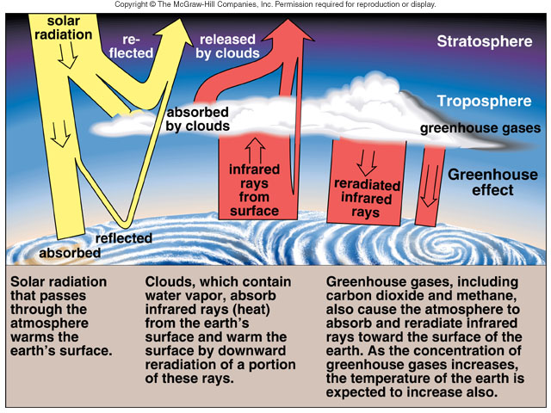
Earth’s radiation balances
Notes:
The contribution of greenhouse gases (far right) to the earth’s surface causes global warming.

Slide 24
Carbon Dioxide and Global Warming
The transfer rate , the amount of a nutrient that moves from one compartment of the environment to another, can be altered by human activities, allowing more carbon dioxide to be added to the atmosphere.
Atmospheric carbon dioxide has risen from 280 ppm to 350 ppm due to burning of fossil fuels and forests.
Besides CO₂, nitrous oxide and methane are also greenhouse gases.
Notes:
The burning of fossil fuels is the primary causes of greenhouse gases increasing in the atmosphere. Other sources of greenhouse gases include methane from feed yards, and other gases from industry.

Slide 25
Similar to the panes of a greenhouse, these gases allow the sun’s rays to pass through but hinder the escape of infrared (heat) wavelengths.
Buildup of more of these “greenhouse gases” could lead to more global warming.
The effects of global warming could include a rise in sea level, affecting coastal cities, and a change in global climate patterns with disastrous effects.

